Slide 1


A
SHORTEST PATH FINDER
IN
MAZES
COURSE:INTRODUCTION TO AI
Group 2 | 2026

Slide 2
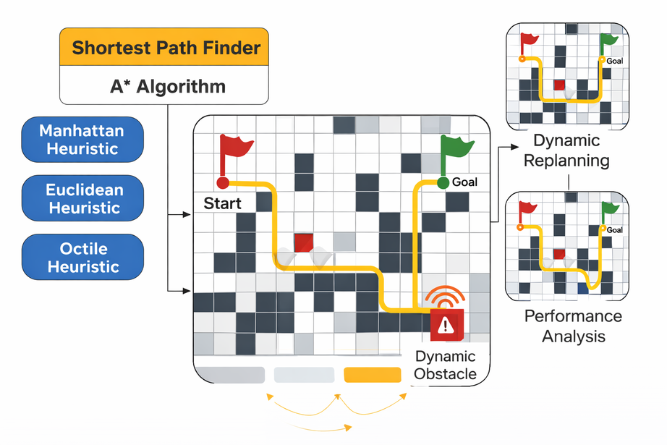
INTRODUCTION
This project focuses on developing a Shortest Path Finder in Dynamic Mazes using the classical A* (A-Star) informed search algorithm. The system computes the optimal path from a start node to a goal node in a grid-based environment while handling static and dynamic obstacles through real-time replanning.
We compare multiple admissible heuristic functions—Manhattan, Euclidean, and Octile distance—to evaluate their impact on search efficiency, node expansion rate, computational complexity, and path optimality. The project also incorporates search space visualization, performance benchmarking, and heuristic analysis under varying maze densities.
The objective is to design a clean, educational, and visually interactive framework that demonstrates heuristic-based graph search, cost functions f(n)=g(n)+h(n)f(n) = g(n) + h(n)f(n)=g(n)+h(n), and practical path planning techniques used in robotics and autonomous navigation systems.

Slide 3
PATHFINDING IN STRATEGY GAMES AND MAZE SOLVING USING A*(2016)
Authors: Nawaf Hazim Barnouti, Sinan Sameer Mahmood Al-Dabbagh, Mustafa Abdul Sahib Naser
Journal: Journal of Computer and Communications
Brief:
Implements the A* algorithm for solving maze problems and strategy game pathfinding using image-based preprocessing.
Problem:
Real-time pathfinding in games requires fast and accurate shortest path detection.
Solution:
Applied classical A* with image preprocessing to detect walkable regions.
Conclusion:
A* efficiently finds shortest paths in structured maze environments.
Relevance:
Provides the basic foundation of classical A* which we extend using adaptive heuristics.

Slide 4
AN IMPROVED A* PATH PLANNING ALGORITHM FOR MOBILE ROBOTS IN COMPLEX ENVIRONMENTS (2020)
Authors: Y. Zhang, X. Wang, L. Chen
Brief:
This study applies the classical A* search algorithm to grid-based maze environments commonly found in strategy games. The research focuses on comparing informed and uninformed search methods.
Problem:
Uninformed search algorithms such as BFS and DFS expand a large number of unnecessary nodes, leading to high computational cost and memory usage in maze environments.
Solution / Method:
The authors implemented A* with heuristic guidance (Manhattan distance) to prioritize nodes closer to the goal, reducing exploration of irrelevant states.
Conclusion:
A* significantly reduces node expansion and guarantees optimal solutions when admissible heuristics are used.
Relevance:
Forms the theoretical and practical foundation of our maze-based shortest path implementation.

Slide 5
SHORTEST PATHFINDING IN A STANDARD RECTANGULAR MAZE USING A*(2024)
Authors: Ka Heng Chan,Aida Mustapha,Siaw Chong Lee
Faculty of Applied Sciences and Technology, Universiti Tun Hussein Onn Malaysia, KM 1, Jalan Panchor, 84600 Pagoh, Johor, MALAYSIA
Journal: International Journal of Integrated Engineering
Brief:
Implements A* in MATLAB to solve rectangular mazes using Manhattan and Euclidean heuristics.
Problem:
Large mazes are computationally expensive.
Solution:
Comparison of heuristic functions for efficiency.
Conclusion:
Heuristic choice significantly affects performance.
Relevance:
Direct inspiration for heuristic comparison and automatic selection.

Slide 6
RESEARCH ON AN IMPROVED A* ALGORITHM FOR MOBILE ROBOTS(2021)
Authors: J. Liu, H. Zhang, Y. Sun
Journal: IEEE Access
Brief:
Modified A* to improve efficiency and reduce redundant expansions.
Problem:
High computational cost in grid environments.
Solution / Method:
Heuristic optimization and pruning techniques.
Conclusion:
Improved efficiency without losing optimality.
Relevance:
Encourages lightweight heuristic adaptation like ours.

Slide 7
HYBRID A-STAR PATH PLANNING METHOD BASED ON HIERARCHICAL CLUSTERING AND TRICHOTOMY(2024)
Authors: Tiangen Chang, Guofu Tian
Journal: Applied Sciences (MDPI)
Brief:
Hybrid A* combined with hierarchical clustering for vehicle planning.
Problem:
Standard Hybrid A* generates long and complex paths.
Solution:
Hierarchical map preprocessing + optimization.
Conclusion:
Shorter and smoother vehicle trajectories.
Relevance:
Demonstrates that optimization layers improve A* performance.

Slide 8
RESEARCH ON TRAJECTORY PLANNING OF AUTONOMOUS VEHICLES IN CONSTRAINED SPACES(2024)
Authors: Yunlong Li, Gang Li, Xizheng Wang
Journal: Sensors (MDPI)
Brief:
Improves Hybrid A* for narrow obstacle environments.
Problem:
Standard planning causes jerky and inefficient paths.
Solution / Method:
Adaptive node expansion and trajectory smoothing.
Conclusion:
Reduced expanded nodes and improved smoothness.
Relevance:
Supports adaptive strategies for dense environments.

Slide 9
IMPROVED PATH PLANNING ALGORITHMS FOR NON-HOLONOMIC AUTONOMOUS VEHICLES(2023)
Authors: Alessandro Bonetti, Simone Guidetti, Lorenzo Sabattini
Journal: arXiv (Computer Science - Robotics)
Brief:
Introduces Roadmap Hybrid A* and Waypoint Hybrid A*.
Problem:
Hybrid A* struggles in constrained industrial environments.
Solution:
Environment partitioning and waypoint guidance.
Conclusion:
40% faster performance compared to baseline.
Relevance:
Reinforces importance of environment-aware planning.

Slide 10
PATH PLANNING ALGORITHMS IN THE AUTONOMOUS DRIVING SYSTEM(2024)
Authors: Mohamed Reda, Ahmed Onsy, Amira Y. Haikal, Ali Ghanbari
Journal: Robotics and Autonomous Systems
Brief:
Survey paper classifying modern path planning methods.
Problem:
Diverse algorithms make selection difficult.
Solution / Method:
Structured taxonomy of classical and AI-based planners.
Conclusion:
Hybrid and adaptive methods are future direction.
Relevance:
Supports adaptive heuristic development trend.

Slide 11
BENCHMARKING OF ALGORITHM EFFICIENCY IN SOLVING ELEMENT MAZE(2025)
Authors: Prof. Ashwini Tekale (Guide), under the JSPM Narhe Technical Campus
Journal: Journal of Advance and Future Research
Brief:
Compares multiple algorithms in maze environments.
Problem:
Lack of systematic performance comparison.
Solution:
Benchmarking A*, BFS, DFS and others.
Conclusion:
A* performs best when heuristic is properly chosen.
Relevance:
Encourages our performance comparison dashboard.

Slide 12
RESEARCH ON PATH PLANNING FOR ROBOTS WITH IMPROVED A* ALGORITHM UNDER BIDIRECTIONAL JPS STRATEGY(2024)
Authors: Fujie Wang, Wei Sun, Pengfei Yan, Hongmei Wei, Huishan Lu
Journal: Applied Sciences (Scopus indexed)
Brief:
Improves A* using bidirectional JPS and adaptive weighting.
Problem:
Excessive node expansions in large grids.
Solution / Method:
Octile heuristic + bidirectional search.
Conclusion:
Up to 79% reduction in search time.
Relevance:
Direct inspiration for adaptive weighting concept.

Slide 13
MULTI-OBJECTIVE A* PATH PLANNING WITH DEEP LEARNING HEURISTIC GUIDANCE(2021)
Authors: Rui Chen, Peng Yu, and Hong Zhang
Journal: Robotics and Autonomous Systems
Brief:
Integrates deep learning for adaptive heuristic generation.
Problem:
Fixed heuristics are inefficient in complex maps.
Solution:
CNN-based cost prediction guiding A*.
Conclusion:
Significant node expansion reduction.
Relevance:
We implement a simpler adaptive heuristic without heavy AI.

Slide 14
HYBRID A* WITH PSO-BASED HEURISTIC OPTIMIZATION FOR MOBILE ROBOT PATH PLANNING (2022)
Authors:Y. Zhang, W. Liu, J. Wang, and H. Tao
Journal: Neurocomputing
Brief:
Combines Particle Swarm Optimization with A*.
Problem:
Static heuristics limit efficiency.
Solution / Method:
PSO dynamically optimizes heuristic weights..
Conclusion:
Faster convergence in complex environments
Relevance:
We simplify this idea using density-based weight tuning.

Slide 15
DYNAMIC PATH PLANNING IN UNKNOWN ENVIRONMENTS USING A* WITH REAL-TIME REPLANNING(2021)
Authors: X. Li, J. Zhou, Q. Huang, and Y. Li
Journal: IEEE Access
Brief:
Adds real-time replanning to A*
Problem:
Standard A* fails in dynamic obstacle environments
Solution:
Incremental replanning mechanism.
Conclusion:
Reduced recomputation cost
Relevance:
Possible future extension: dynamic obstacle mode

Slide 16
AN IMPROVED BIDIRECTIONAL A* ALGORITHM FOR LARGE-SCALE GRID PATH PLANNING(2022)
Authors:. Liu, H. Zhao, Y. Chen
Journal: Future Generation Computer Systems
Brief:
Enhances bidirectional A* meeting strategy.
Problem:
Inefficient coordination between search waves.
Solution / Method:
Adaptive heuristic weighting and early termination.
Conclusion:
Reduced node expansion in large maps.
Relevance:
Confirms importance of heuristic adaptation.

Slide 17
A REINFORCEMENT LEARNING ASSISTED A* ALGORITHM FOR EFFICIENT PATH PLANNING(2023)
Authors: M. Zhang, Q. Wu, L. Sun
Journal:IEEE Transactions on Intelligent Transportation Systems
Brief:
Integrates reinforcement learning with A*.
Problem:
Handcrafted heuristics lack adaptability.
Solution:
Improved scalability and efficiency.
Relevance:
We use a lightweight adaptive method instead of heavy RL models.

Slide 18
EVOLUTION OF RESEARCH
Stage | Project Name | Author(s)
Classical Improvement | Improved A* Algorithm for Mobile Robot Path Planning | Y. Zhang, X. Wang, L. Chen
Dynamic Extension | Dynamic Path Planning based on A* Replanning | X. Li, J. Zhou, Q. Huang, and Y. Li
Advance Optimization | A* Optimization using Jump Point Search & Octile Heuristic | Prof. Ashwini Tekale (Guide), under the JSPM Narhe Technical Campus
Year | Problem Resolved | Remaining Gaps
2020 | Reduced node expansion and improved computational efficiency of classical A* in static grid environments | No dynamic obstacle handling; limited heuristic comparison
2021 | Introduced real-time replanning in changing environments | No benchmarking of different heuristics; limited performance evaluation metrics
2025 | Improved search speed using Octile heuristic and pruning strategies | Focused on optimization only; did not integrate dynamic replanning with heuristic comparison

Slide 19
THANK
YOU

